Slide 1

Website Selling Clothes
Project Report
http://www.free-powerpoint-templates-design.com

Slide 2
Group 2
CE140484
CE140122
CE140320
Tran Chan Duong
Huynh Thi Nhien
Huynh Ba Dat
Mentor Luong Hoang Huong

Slide 3
1
Problem Definition
3
Interface
2
4
User Requirement
Demo
Table Of Content

Slide 4
1.
Problem Definition

Slide 5
Traditional Shop
1
Must be in the shop at all times
2
Easy to lose notesbooks
3
Must calculate by handheld calculator
4
Difficulty in calculating with too many data
5
Difficulties in making reports at the end of the month

Slide 6
Traditional Shop
6
Continuous monitoring of import and export goods
7
Difficulties in management
8
Marketing costs a lot of money
9
Many costs include: space, electricity, water, ..
10
Limited sales time

Slide 7
Website Selling
Option E
Option D
Can manage many transactions
Option C
Can access on multiple devices
Easy to calculate
Easily store transaction information
Option B
Save a lot of time
Option A

Slide 8
Website Selling
Option E
Option D
Saves marketing time and costs
Option C
The product price is cheaper
Easily make reports
Saving a lot of costs
Option B
Sales with 24/7 time
Option A

Slide 9
2.
User Requirement

Slide 10
User Requirement
Provides a good graphical interface and user-friendly program
01
Easy in report the revenue and profit of the day
02
03
Might find and change information easily
04
Might add new product into menu

Slide 11
User Requirement
05
Add delete edit news articles
06
Record customer orders
07
Website management updates order status
08
Shopping cart allows multiple products at once

Slide 12
3.
User Interface

Slide 13
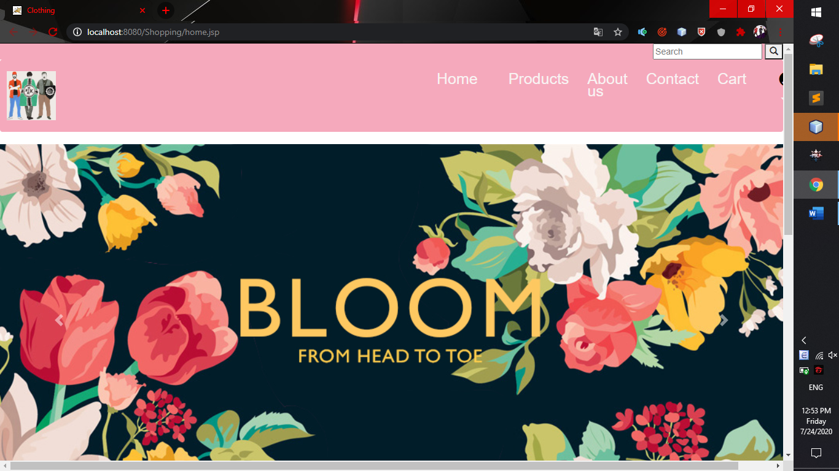
User Interface
Figure 1. Home Page

Slide 14
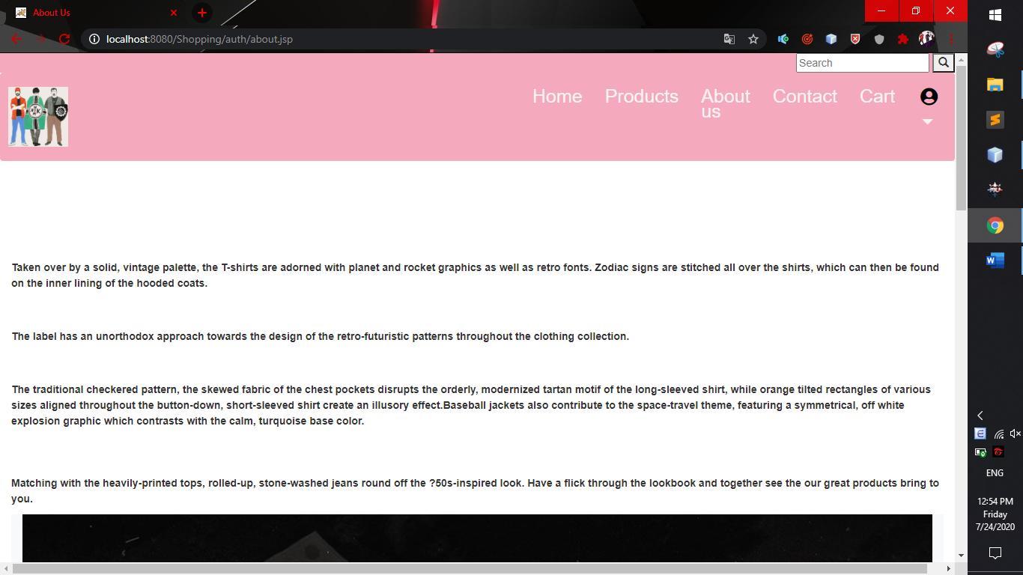
User Interface
Figure 2. About Us

Slide 15
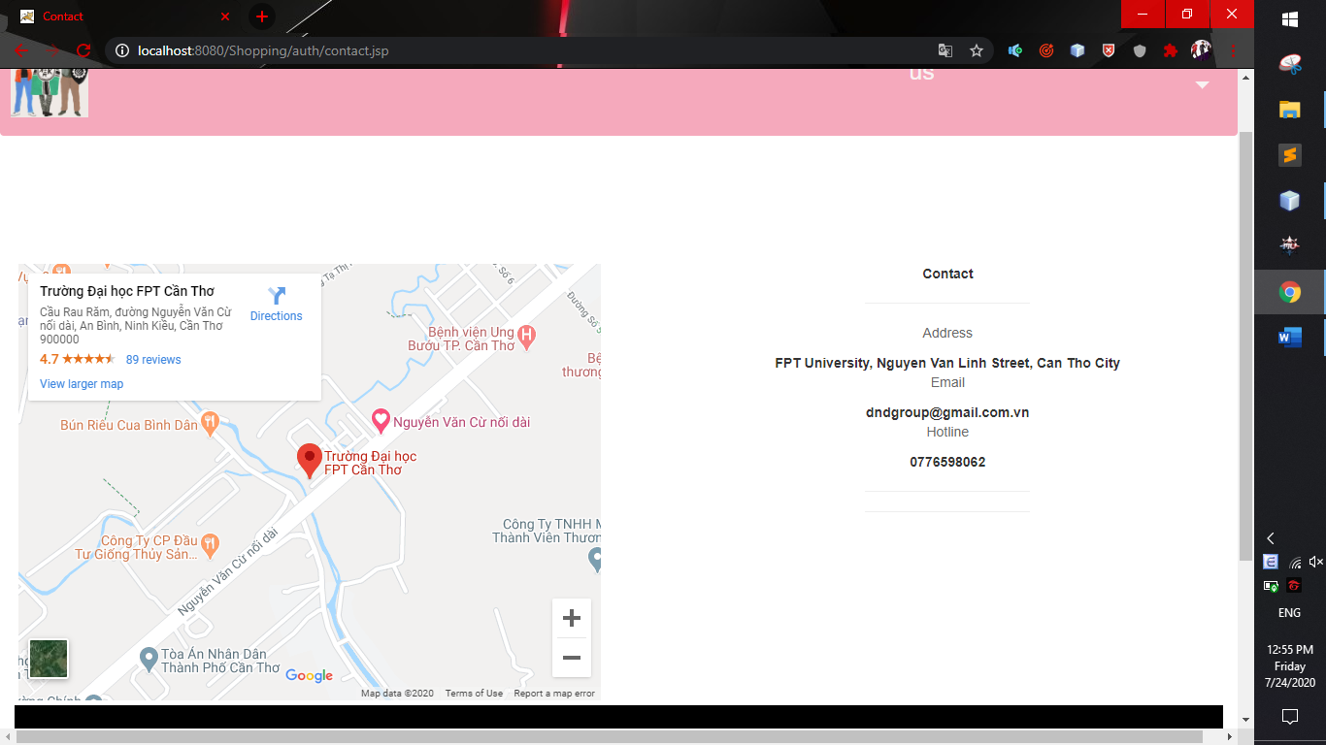
User Interface
Figure 3. Contact Us

Slide 16
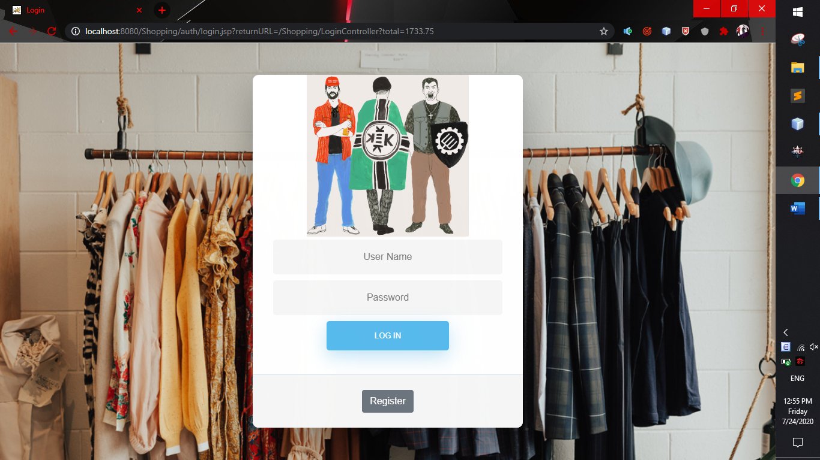
User Interface
Figure 4. Login Page

Slide 17
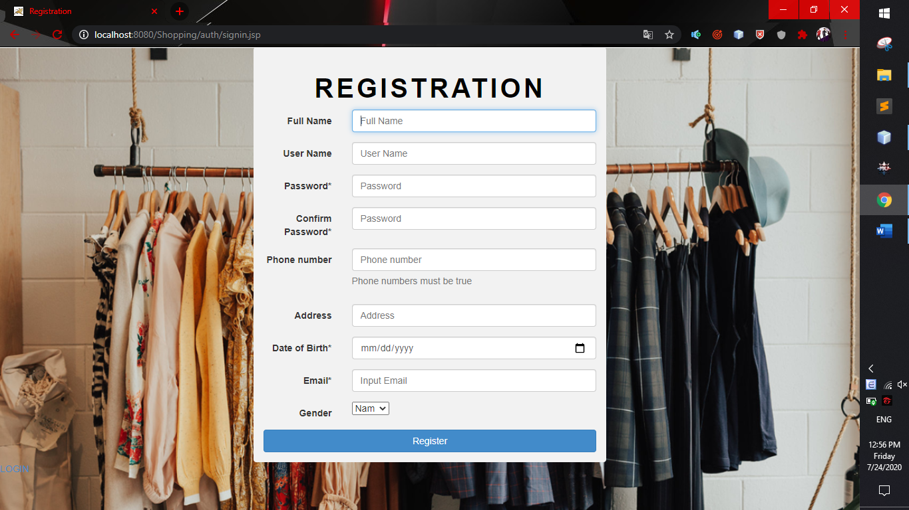
User Interface
Figure 5. Register Page

Slide 18
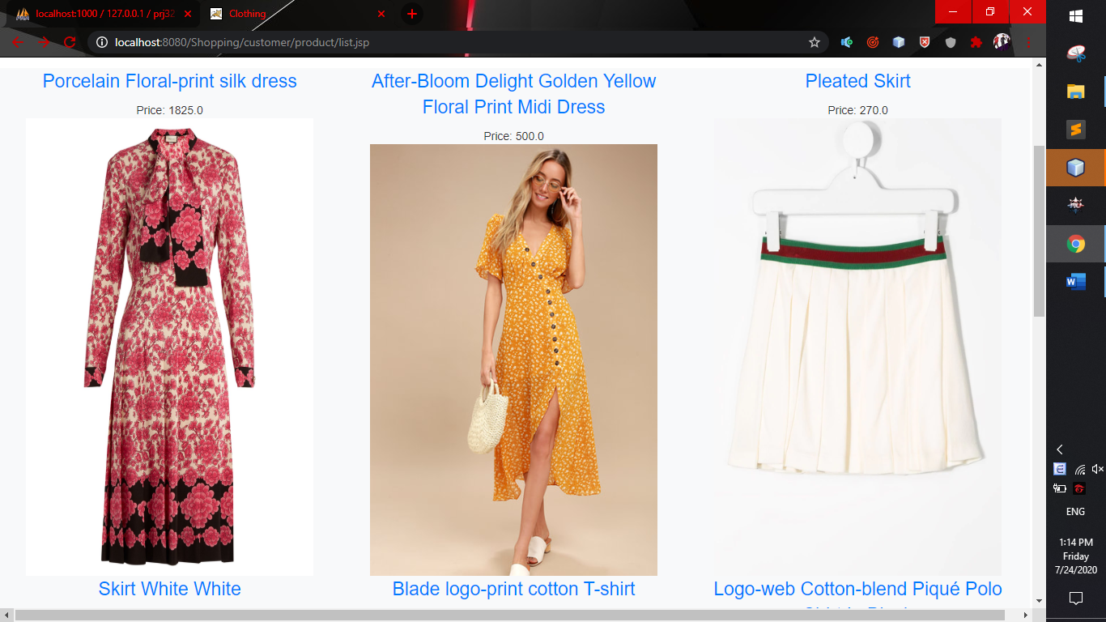
User Interface
Figure 6. Products Page

Slide 19
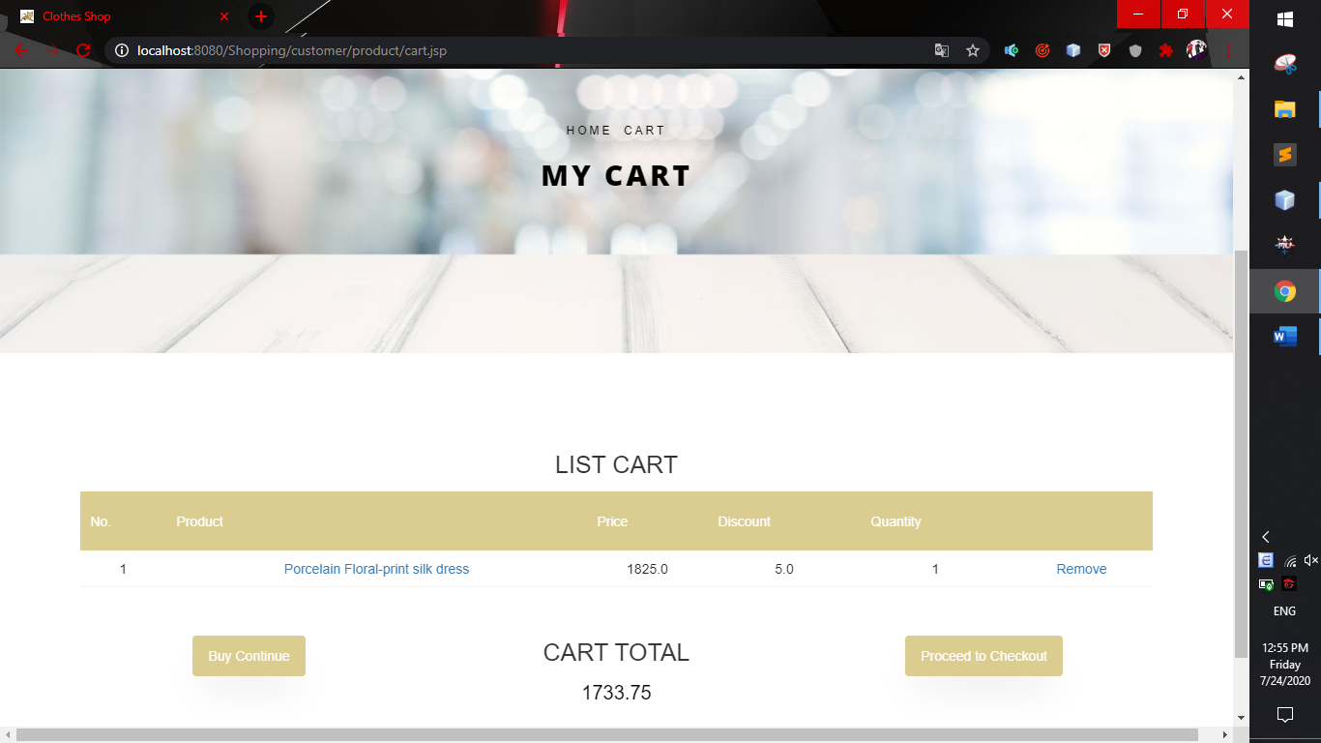
User Interface
Figure 7. Cart Page

Slide 20
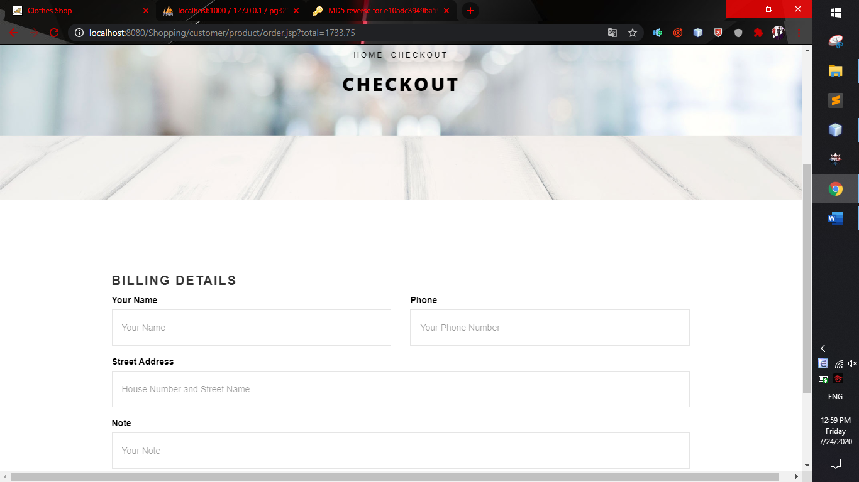
User Interface
Figure 8. Checkout Page

Slide 21
4.
Demo

Slide 22
THANK YOU
Insert the Subtitle of Your Presentation

